Slide 1
Presenting Your Research
Experimental Psychology

Slide 2
Ways to present your research
Empirical report
Oral presentation
Poster presentation

Slide 3
APA Style
Title page
Abstract
Introduction
Method
(Results)
(Discussion)
References

Slide 4
A few things before we get started
Sample size- make large if possible
Factorial design
  “Does X and X impact Y?

Slide 5
Title Page
Running Head
  Running head needs to have MEANING
  Running head is left-justified, at the top of the title page, and written as follows:
  Running head: GENDER AND MEMORY
Title
  10-12 words in length; CONCISE
  Centered and double-spaced
Your name and name of institution (double-spaced and centered below title)
NO Author’s Note

Slide 6
Running head: WRITING A RESEARCH PAPER 1
How to Write an APA Style Research Paper
Judy Orton Grissett
Georgia Southwestern State University

Slide 7
Abstract
150-250 word summary of the study
Write this part last, even though it follows the title page
CONDENSED version of complete paper:
  Introduction of problem
  Name of variables/concepts
  Brief presentation of method
  Mention of important results
  Brief discussion of implications

Slide 8
Introduction
The heading of the introduction is the title of the paper, NOT the word “Introduction”
Background or orienting information
  What is the problem and why is it important?
Include very brief description of current study here (i.e., how will you address the problem?)
  State type of research here (Experimental, correlational, quasi-experimental, etc.)

Slide 9
Literature Review
Literature Review
  Use your research question/hypotheses to guide the organization and content of your lit review
Include literature relevant to your research topic
  At least eight references (peer-reviewed )
At the end, formally state the purpose and research questions and/or hypotheses

Slide 10
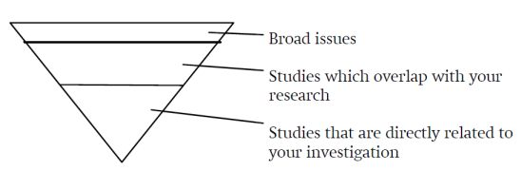
How to conduct a lit review
Image: https://libguides.reading.ac.uk/literaturereview/starting

Slide 11
Method
Participants
  Who are they? (gender, age, race, SES)
  How many are there? (with appropriate breakdowns of gender, age, race, etc.)
  How were they selected/recruited/screened (list sampling method here)?
  Were they compensated or not?
Procedures
  Specify what happened to each participant
  Summarize each step of study
  Detail is key here!

Slide 12
Method Cont’d.
Measures
  Describe each measure used
  For each measure, provide sample items and response choices
  Describe operational definitions of variables

Slide 13
Method of Analysis
Include a brief description of method of statistical analysis
  ANOVA, t-test, chi-square, regression analysis, etc.
State why you chose this method (Because you are comparing two groups? Because you are looking at multiple independent variables? Etc.)
Do NOT need to include any results here.

Slide 14
References APA Style
Shell, E. M., & Eisenberg, N. (1996). Children's reactions to the receipt of direct and indirect help. Child Development, 67(1), 1391-1405.
In-text citations:
As Shell and Eisenberg (1996) found...
Several researchers found that... (Maloney, 1997; Shell & Eisenberg, 1996)
NOTE: Parenthetical citations in alphabetical order

Slide 15
Valuable resources
APA Website
OWL Purdue

